Slide 1

neural networks
Pradeep Pujari

Slide 2

WELCOME
Please sit at a table with people you don’t normally work with. Introduce yourselves and discuss your experience with Neural Networks.
DIRECTIONS
Use the yellow post-it notes to write down questions or topics you would like to discuss.
Use the purple post-it notes to write down resources or tips/tricks you would like to share.
Once you have your thoughts documented, place them on the designated areas on the whiteboards side of the room.

Slide 3

A little about me
https://ppujari.github.io/
@ppujari
Disclaimers**
Notes:
Maker group?
Speakers? What is ML and why it is important? Study of algorithms that learns from experiences
Workshops?

Slide 4
Agenda
Machine Learning Intuition
Machine Learning to Deep Learning
Human Brain and Neurons
How to program a Neuron
Simple Neural Net Example
Notes:
Maker group?
Speakers?
Workshops?

Slide 5
ML programming model
No Business Rules
Algorithms learn from data
Programming in python, C++
Notes:
Maker group?
Speakers? What is ML and why it is important? Study of algorithms that learns from experiences
Workshops?

Slide 6
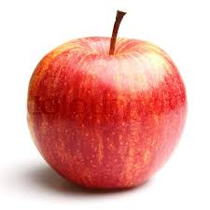
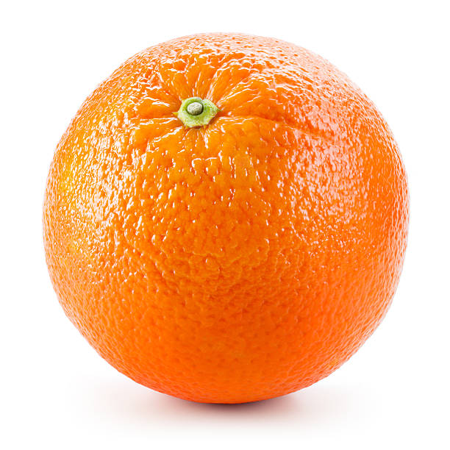
How to write code to detect Fruit

Slide 7
Def detect_color( image ) :
#lot of code
Def detect_texture( image ) :
#lot of code
Def anlyze_shape( image ) :
#lot of code
Def define_fruit ( image ) :
#lot of code
Notes:
Maker group?
Speakers? What is ML and why it is important? Study of algorithms that learns from experiences
Workshops?

Slide 8
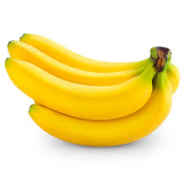
What about this?

Slide 9
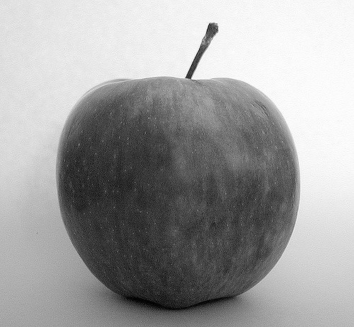
What about this image?

Slide 10


Slide 11
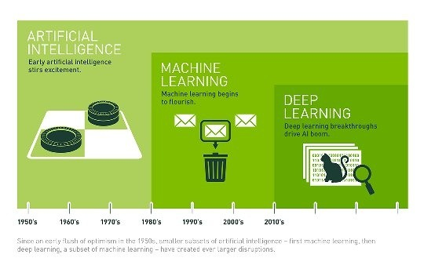
AI Evolution

Slide 12
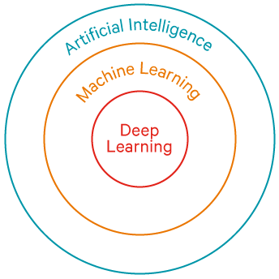

Slide 13
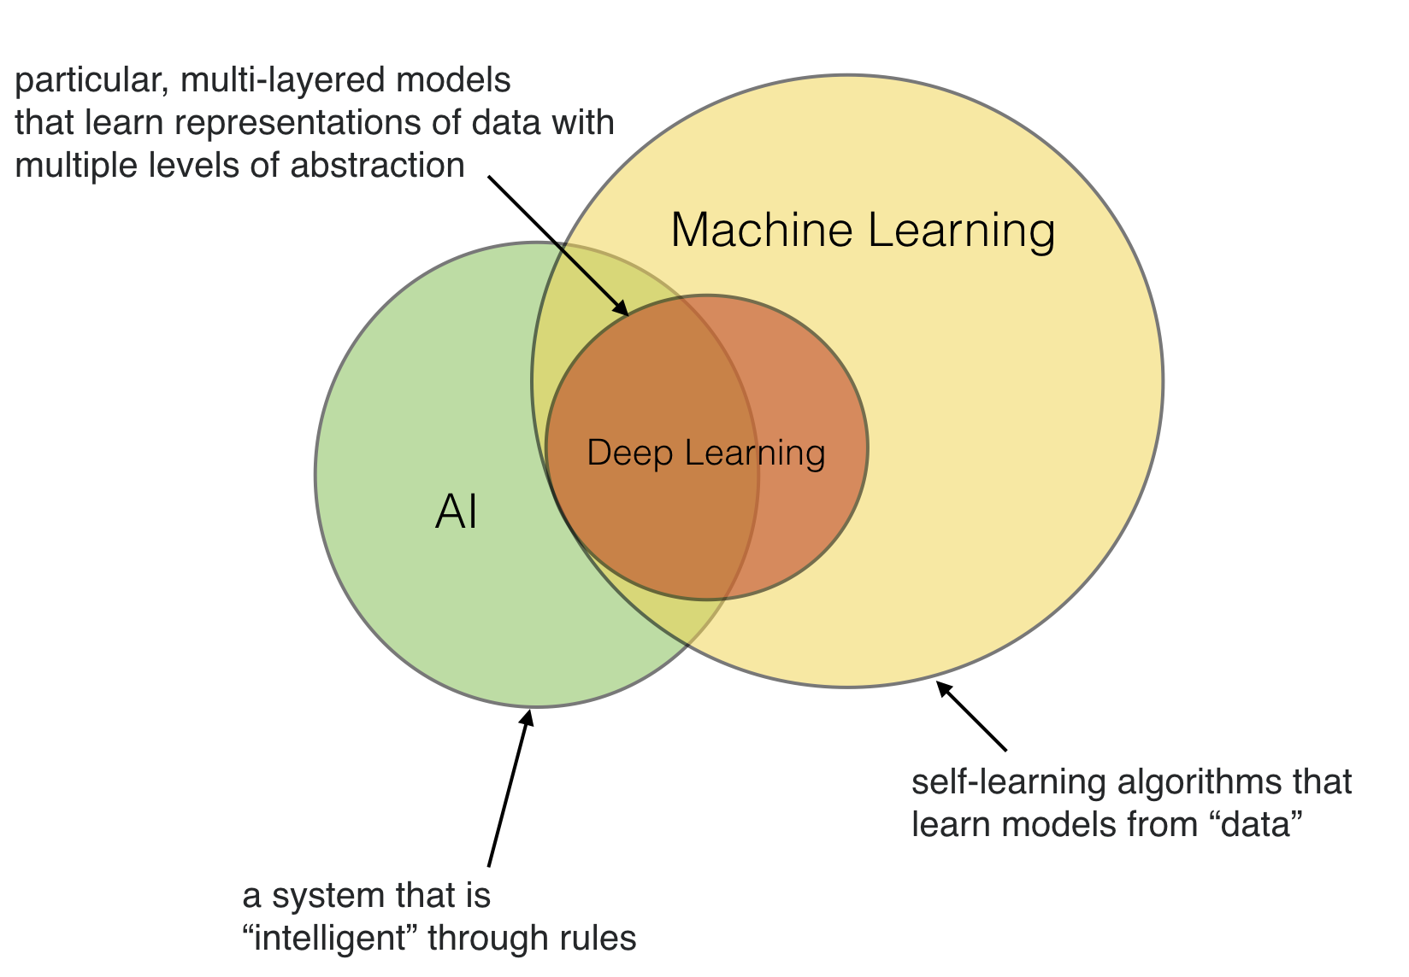

Slide 14
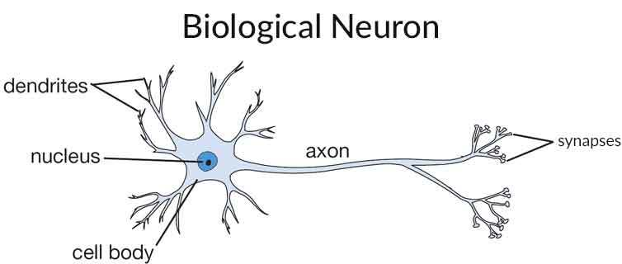

Slide 15
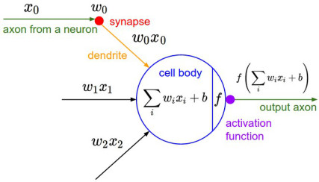

Slide 16
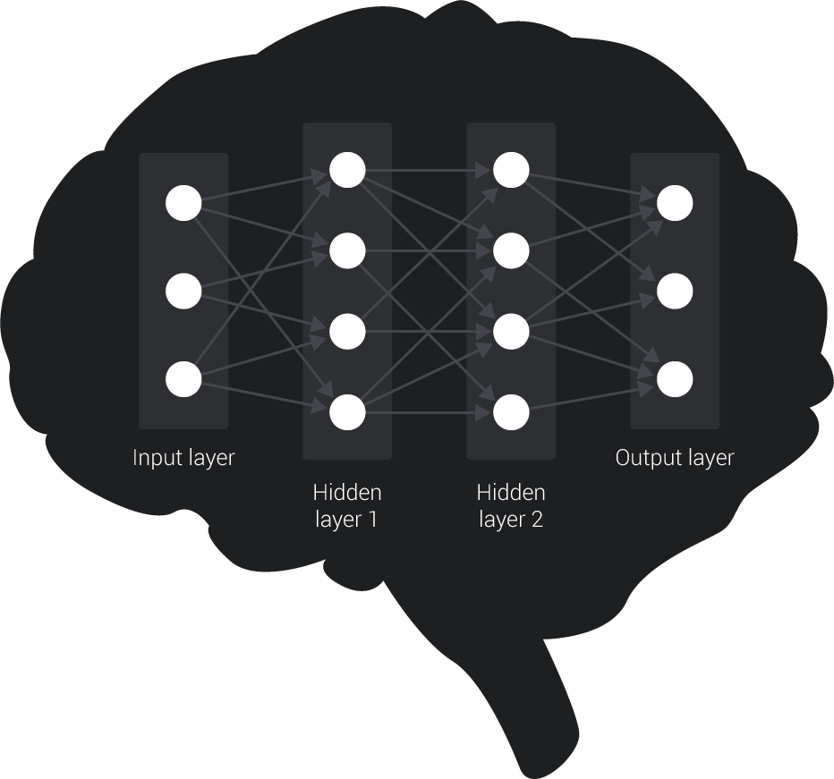
Brain as a Neural Network
Notes:
A neural network can be thought of as a search problem. Each node in the neural network is searching for correlation between the input data and the correct output data.

Slide 17
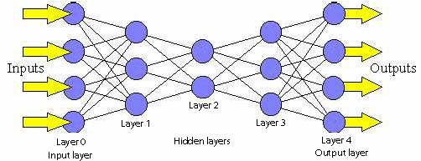
Simple Neural Network

Slide 18
Feed Forward Network
neurons arranged in layers
middle layers no connection with external world
no connection among neurons in the same layer
Each neuron in one layer connected to every neuron on the next layer
Notes:
Maker group?
Speakers? What is ML and why it is important? Study of algorithms that learns from experiences
Workshops?

Slide 19
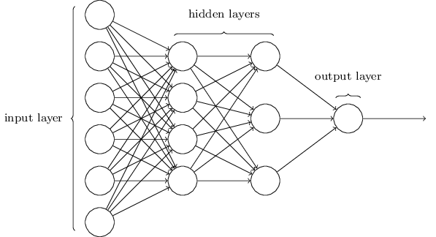
Simple Neural Network

Slide 20
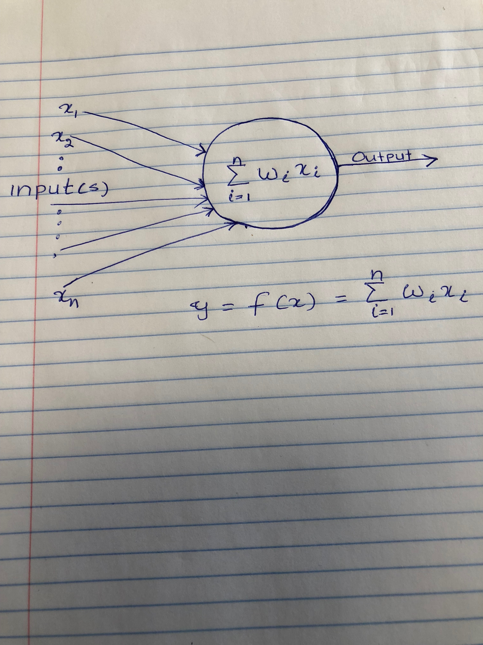

Slide 21

Notes:
Maker group?
Speakers? What is ML and why it is important? Study of algorithms that learns from experiences
Workshops?

Slide 22
Tennis ML App

Slide 23
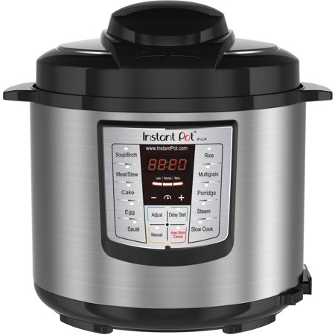
Instant Pot Programmable Pressure Cooker

Slide 24
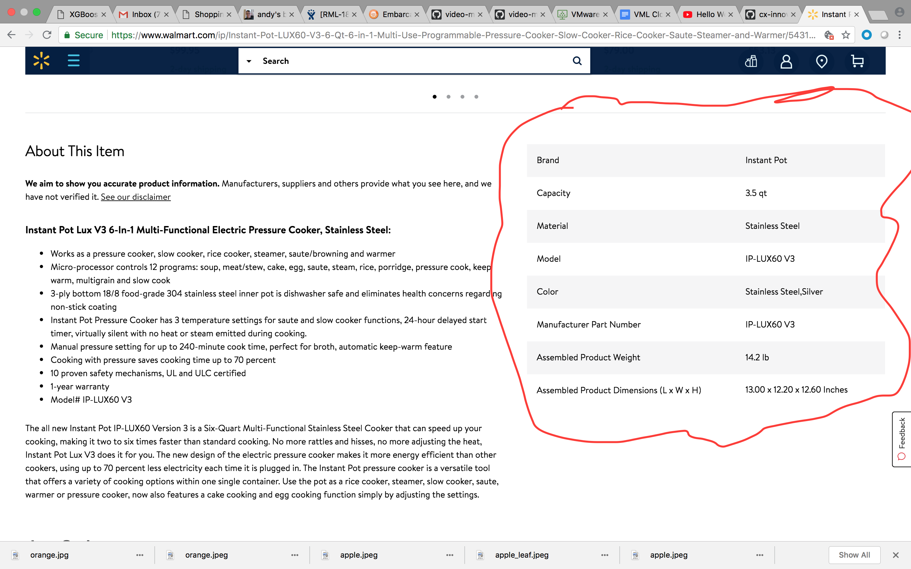

Slide 25
State of AI today
Evolution of AI

Slide 26
How to program a Neuron
Neuron Code here

Slide 27
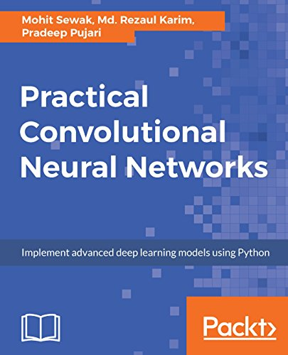
Practical Convolutional Neural Networks

Slide 28

LET’S
DISCUSS...

Slide 29
THANK
YOU!
Notes:
Maker group?
Speakers?
Workshops?

